Slide 1

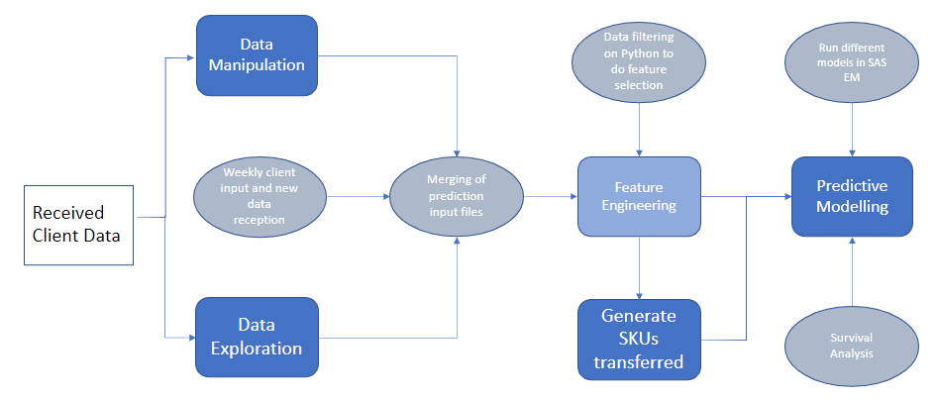
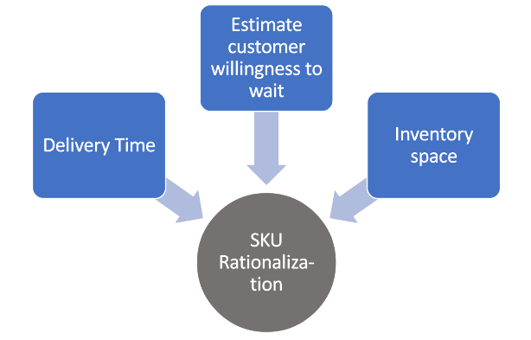
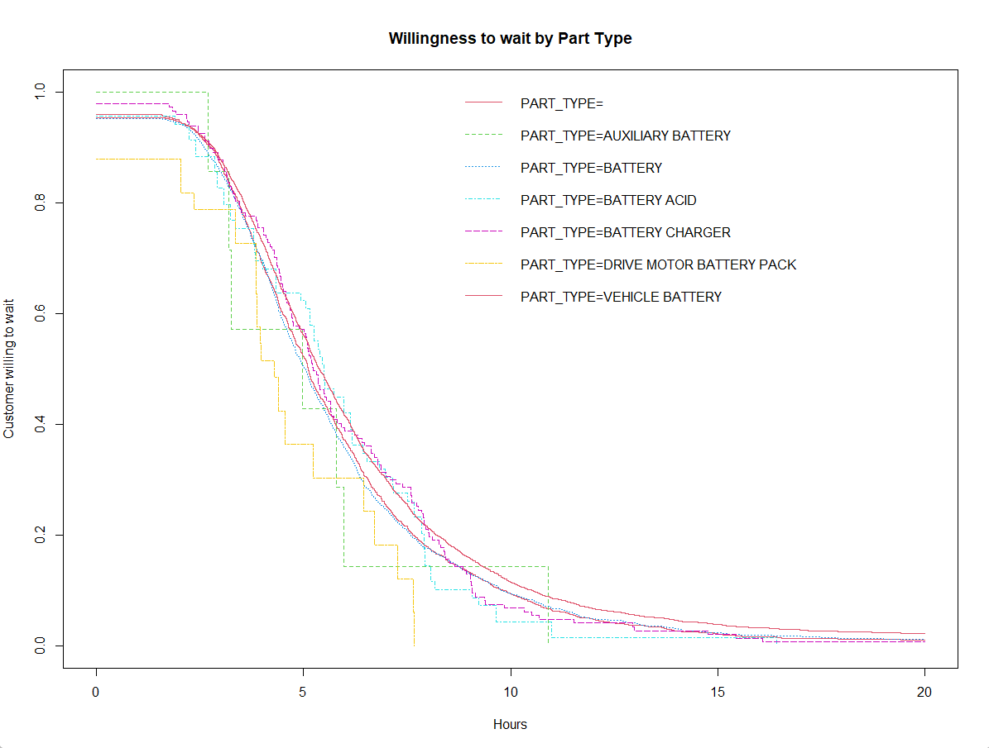

Customer’s Willingness to Wait
Aman Bhargava, Aditya Gupta, Arjun Dayal Mishra, Simranjeet Singh Khalsa, Yang Wang
Purdue University, Krannert School of Management
bharga25@purdue.edu; gupta713@purdue.edu; mishr120@purdue.edu; khalsa@purdue.edu; yangwang@purdue.edu
ABSTRACT
METHODOLOGY
A model to predict the number of days a customer is willing to wait for a specific SKU based on historical data that will help companies better anticipate customer needs by stocking units for which willingness to wait is low. The model will eventually help in a company’s aim to achieve SKU rationalization on sales due to lack of inventory. The willingness to wait for an SKU is dependent on multiple factors like part type, customer requirement and urgency, delivery time to the closest store. Hence, the analysis needs to be done at an SKU level for a cluster of stores using survival analysis tracking the customer drop-off for products. Hence, we predict the time a customer is willing to wait for a specific SKU using survival and regression concepts in Python, R and SAS.
Expected Business Impact
Inventory Cost
Reduce inventory cost on SKUs for which customers are willing to wait
Sales Prediction
Better prediction for Lost sales due to excessive product wait time
Feature Identification
Reduce Wait time
Minimising Lost sales
Customer Satisfaction
Understanding and interpreting the key features leading to delay in the product wait time
Detecting SKUs for which customers are not willing to wait and eliminate or reduce wait time
Minimizing SKUs’ losses due to lack of part in inventory when required
Improving customer satisfaction with the product
INTRODUCTION
A retail chain often loses its customers to competitors by not having required inventory on hand. What we are aiming at is customer retention without providing the service. It is as ambitious as it sounds. To offset the problem of losses due to supply chain gaps – we devise forecasting models to predict the demand for particular SKU models
Fig 2. Methodical Design
The first step undertaken was to clean the data received from the client and conduct data exploration to find key insights about the data. The data was cleaned, and missing values were imputed using CART in R and other methods specified for categorical variables by the client. A list of SKUs that had been sold after being transferred was generated to use as a sample case for instances where the customer was willing to wait for a product. These cases where the customer was willing to wait were marked as 1, signifying the occurrence of an event. Meanwhile, variables classified as non-important by the client were dropped before modeling. A survival analysis will be conducted on a SKU level using Kaplan-Meier plots and Cox proportional Hazard model. The drop-off rate of customers as time passes for a specific SKU, was studied using survival analysis techniques. Multiple models were used in SAS Enterprise Miner to compare outputs of different models to select and further study the significant variables.
CONCLUSIONS
Brick-and-mortar stores of any retailer face the same challenge – optimizing the physical space available to best display and store products that customers from the area may want to buy. Companies need to decide on SKUs they want to hold in stores and hold the other SKUs in nearby stores or warehouses and have them delivered when required. However, some companies offer time sensitive products for which customers may not be able to wait for another store to return.
Thus, in this study we created outputs that could be used to identify the SKUs for which a customer is not willing to wait or in other cases estimate the ideal number of days a customer would wait for a particular SKU. This would then feed in as an input for the client to feed into their SKU Rationalization algorithms, eventually helping them minimize losses due to lack of SKU in inventory when required.
Fig 1. Graphical representation of workflow
Our research mainly is focused on:
How do we quantify customer wait times for a particular product?
What is the business impact and effects on revenue due to this project?
LITERATURE REVIEW
STATISTICAL RESULTS
Title | Author | Summary
Customer-Order Information, Lead times, and Inventories | Hariharan & Zipkin (1995) | Inventory policy based on demand vs supply lead time
Improving inventory system performance by selective purchasing of buyers’ willingness to wait | Muzzafer Alim & Patrick Beullens (2021) | Markov Decision process by backward induction for inventory replenishment
Assessing product availability in omnichannel retail networks in the presence of on-demand inventory transshipment and product substitution | Shahab Derhami, Benoit Montreuil and Guilhem Bau (2020) | Employing on-demand inventory transshipments to avoid lost sales due to incomplete product availability
Achieving and Sustaining an Optimal Product Portfolio in the Healthcare Industry through SKU Rationalization, Complexity Costing, and Dashboards | David Hilliard (2012) | Importance of delivery time and tie-in to sales impact and cost complexity analysis
How does inventory pooling work when product availability influences customers’ purchasing decisions? | Hisashi Kurata (2014) | Development of a model taking in two variables Poisson demand and Bernoulli customer response to out-of-stock items.
Dynamic Inventory Management with Learning About the Demand Distribution and Substitution Probability | Li Chen, Erica L. Plambeck (2008) | Deriving maximum likelihood estimators (MLEs) of the demand rate and probability that customers will wait for the product.
The drop-off rate for each part type was plotted using the survival analysis techniques. Key insights were generated using Cox models, such as customers would be willing to wait 5% less for a vehicle battery as compared to another type. Similar plots could be built using different variables to track the corresponding rate of customer drop-off. One can also use different age buckets to plot drop-off rates by age to do a similar analysis to understand the impact of age. Willingness to wait generally increases by age. Some outliers are observed due to lack of data. The use of different models on SAS EM then allows us to explore different models easily from which a best model can be selected for easier implementation on Python. The outputs can be then used for better SKU rationalization.
ACKNOWLEDGEMENTS
We would like to thank Professor Yang Wang and our client mentor for their guidance and support on this project.
FEEDBACK
We would appreciate any feedback that the judges wish to share with us. Please scan the QR code to submit your ratings and comments with us
Fig 3. Customer drop-off by part type

